Slide 1
Web Application Security
Chris Edwards
Quintin Cutts
Steve McIntosh

Slide 2
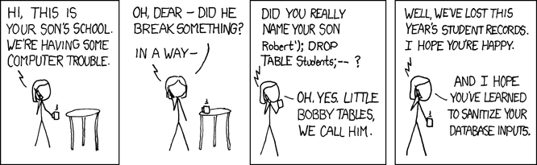
http://xkcd.com/327/

Slide 3
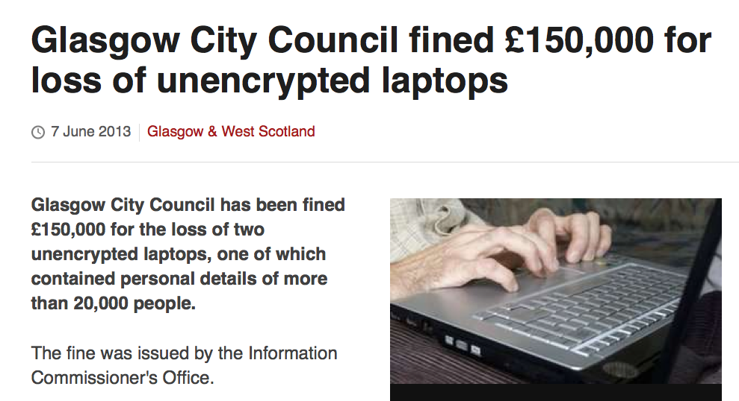

Slide 4
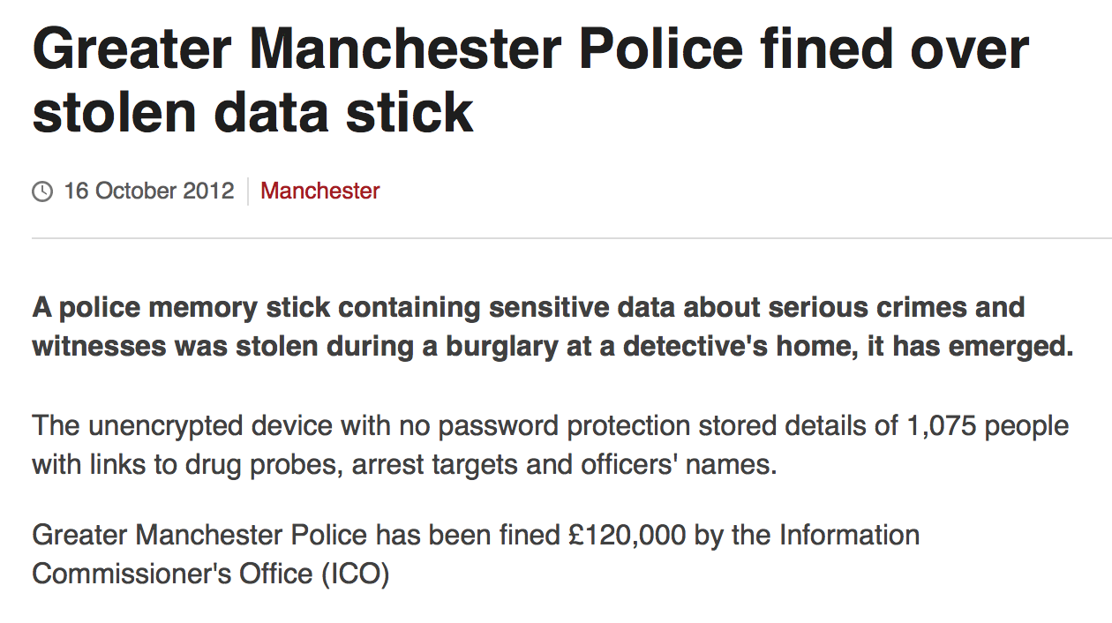

Slide 5
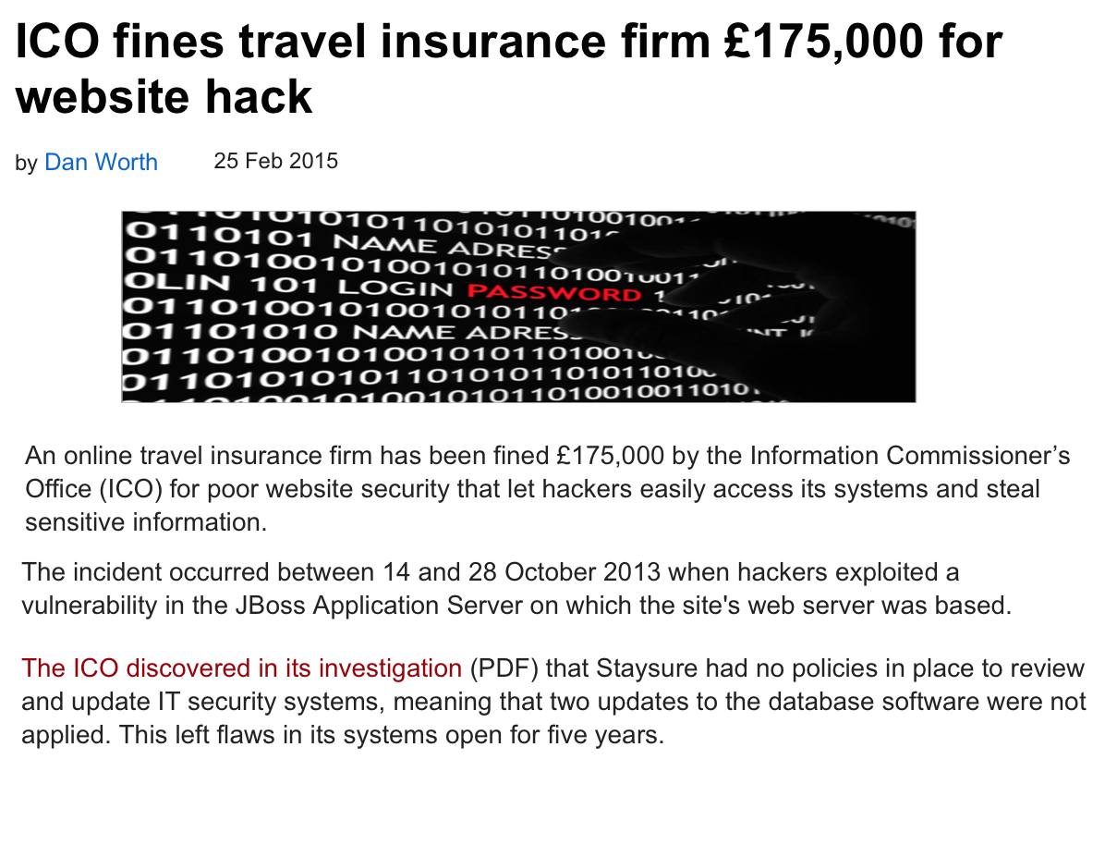

Slide 6
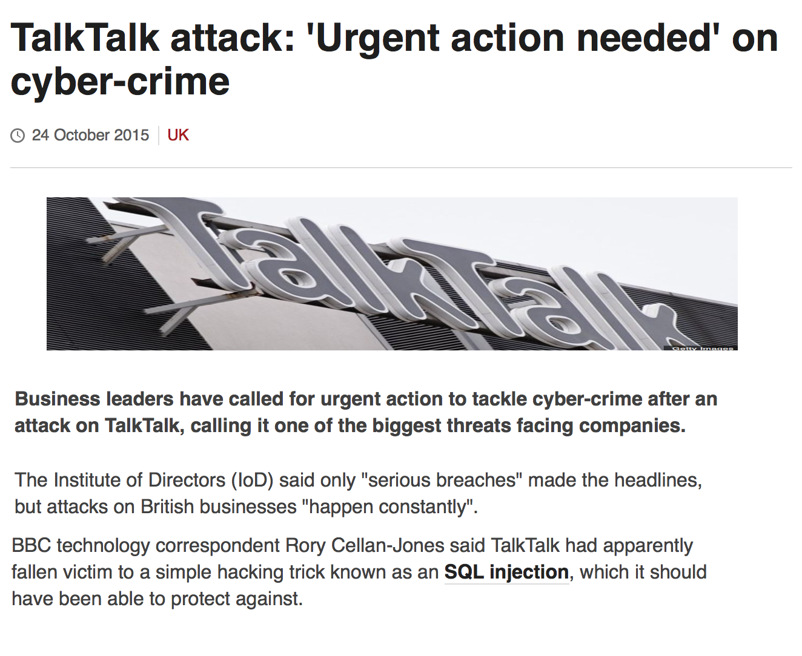

Slide 7
SQL Injection
Example:
Look up customer details, one at a time, via customer ID.

Slide 8
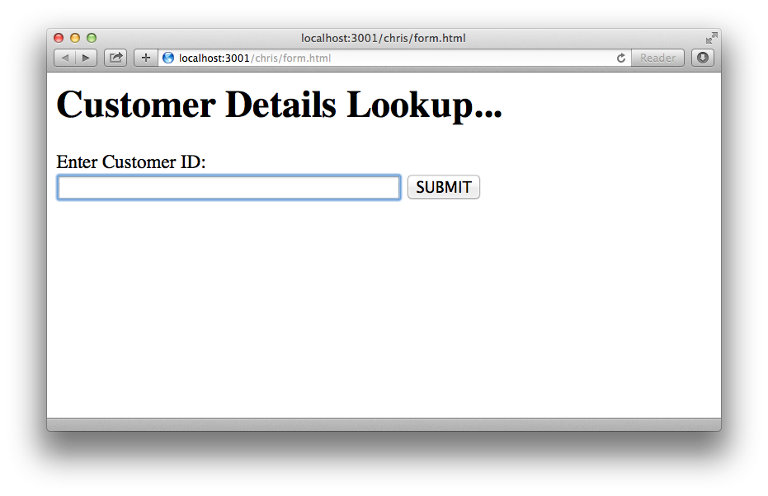

Slide 9
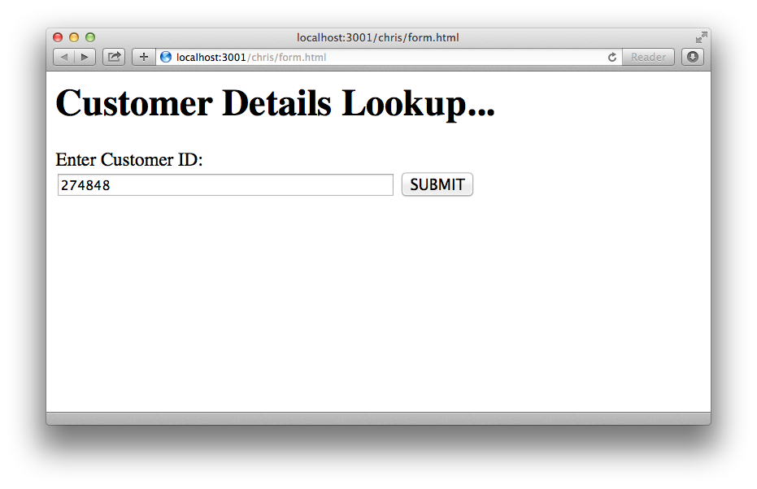

Slide 10
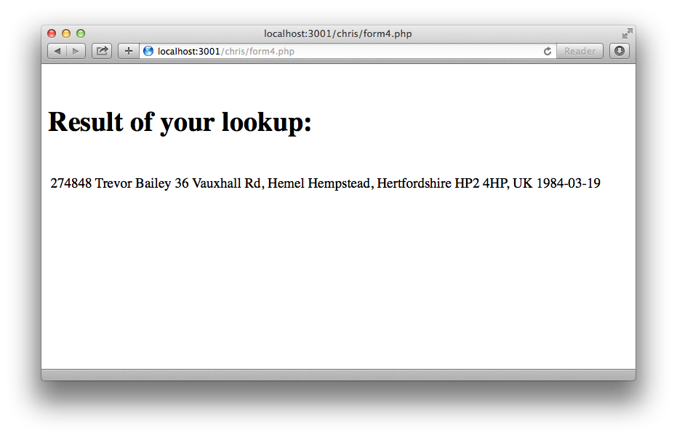

Slide 11
$mysqli= new mysqli($host,$dbuser,$dbpass, $dbname);
$id= $_POST{'id'};
# SQL query (dynamic)
$query = "SELECT * FROM cust WHERE id = $id";
$result = $mysqli->query($query);

Slide 12
SELECT * FROM cust WHERE id = 274848;

Slide 13
274848
274848 OR 1 = 1
$query = "SELECT * FROM cust WHERE id = $id ";
$query = "SELECT * FROM cust WHERE id = 274848 OR 1 = 1";

Slide 15
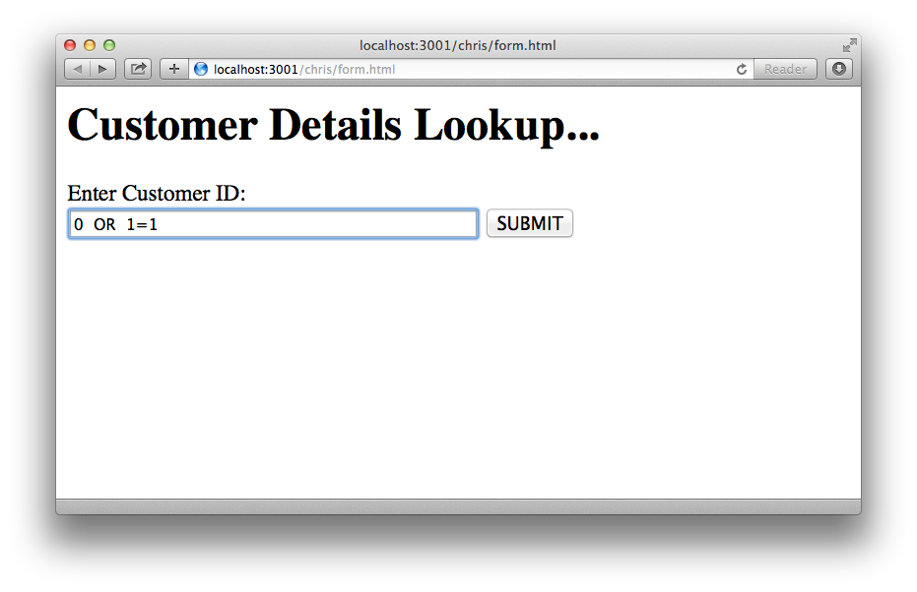

Slide 16
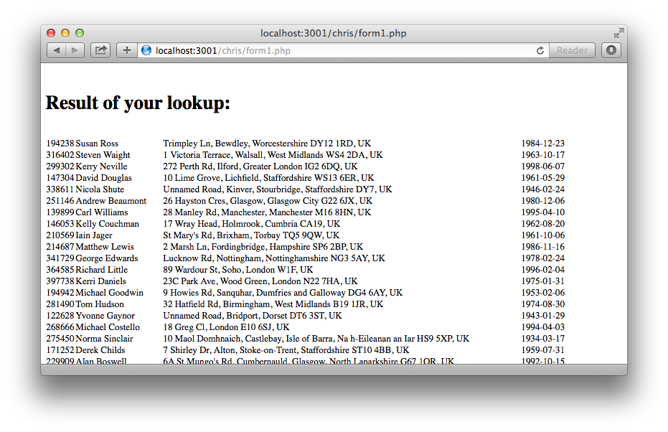

Slide 17
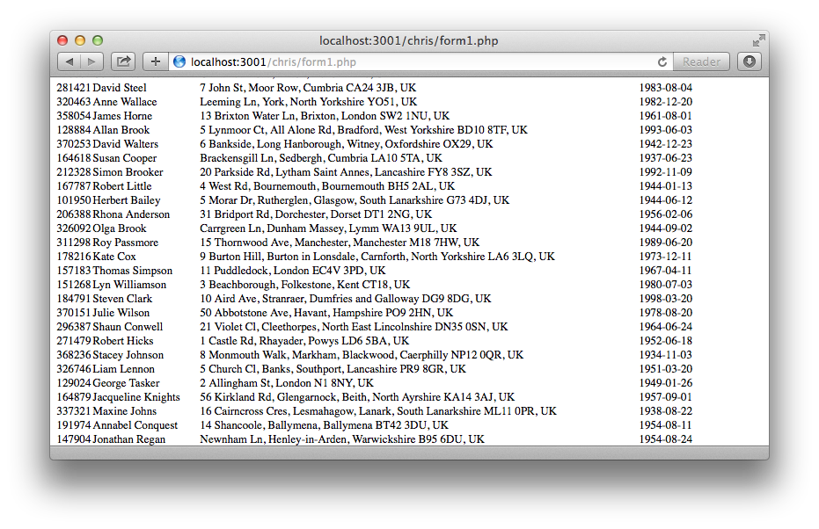

Slide 19
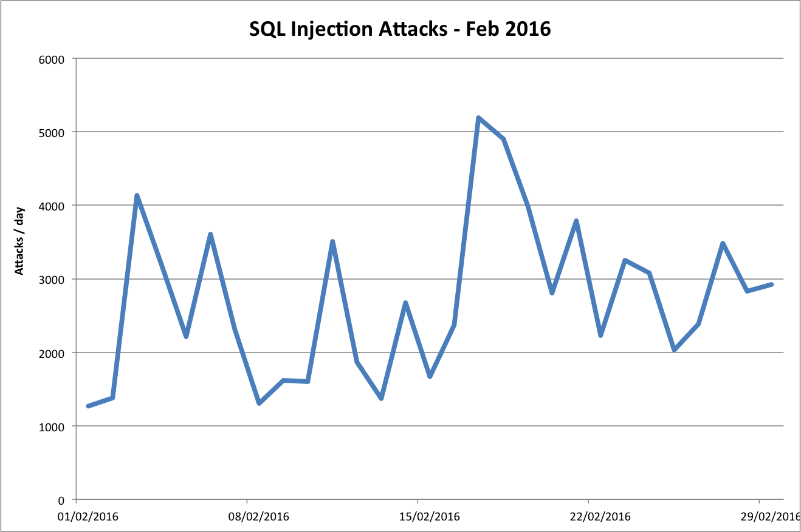

Slide 20
How to fix the code…
Sanitise untrusted inputs
Prepared Statements (with Parameterised Queries)

Slide 21
$id= $_POST{'id'};
# SQL query (dynamic - vulnerable)
$query = "SELECT * FROM cust WHERE id = $id";
$result = $mysqli->query($query);

Slide 22
How to do it right…

Slide 23
$id= $_POST{'id'};
# SQL query (prepared)
$query = "SELECT * FROM cust WHERE id = ?";
$stmt = $mysqli->prepare($query);
$stmt->bind_param(“s", $id);
$stmt->execute();
$stmt->bind_result($id, $name, $addr, $dob);

Slide 24
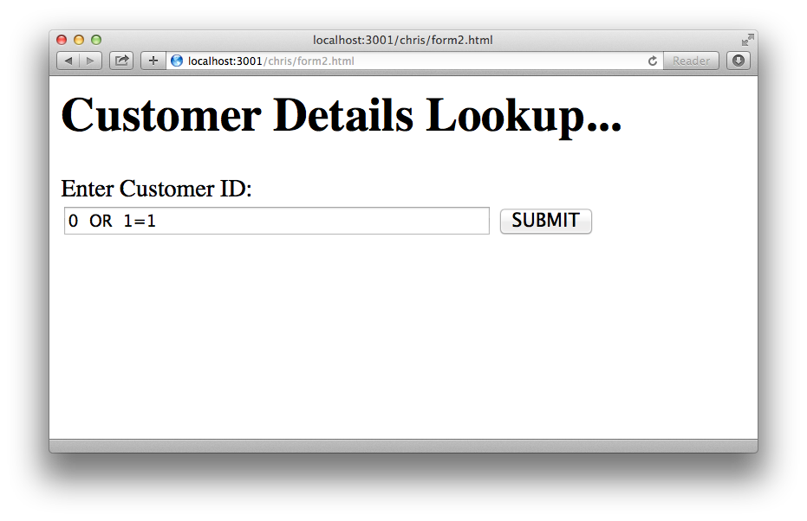

Slide 25
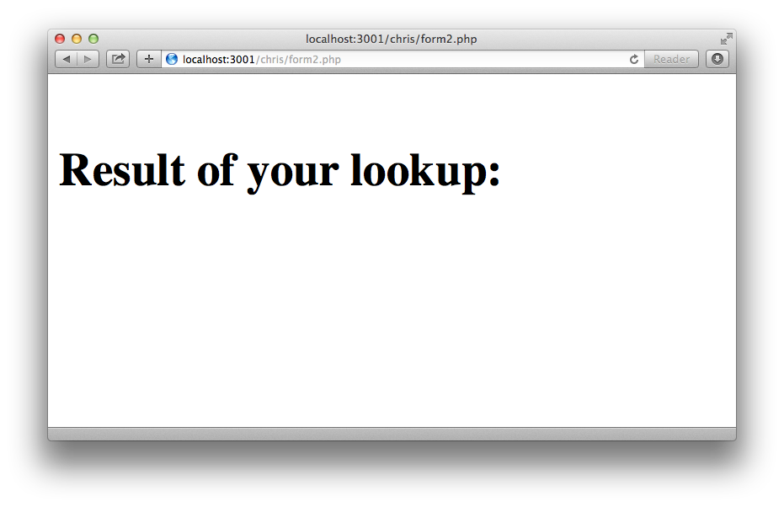

Slide 26
Other Web Application Flaws

Slide 27
Open Web Application Security Project
(OWASP)
OWASP Top Ten
https://www.owasp.org/index.php/Top_10_2013-Top_10

Slide 28
Our advice - go through the OWASP Top Ten list, and for each common flaw:
Check if it may apply to your situation
Consider whether you've taken sufficient steps to address it.

Slide 29
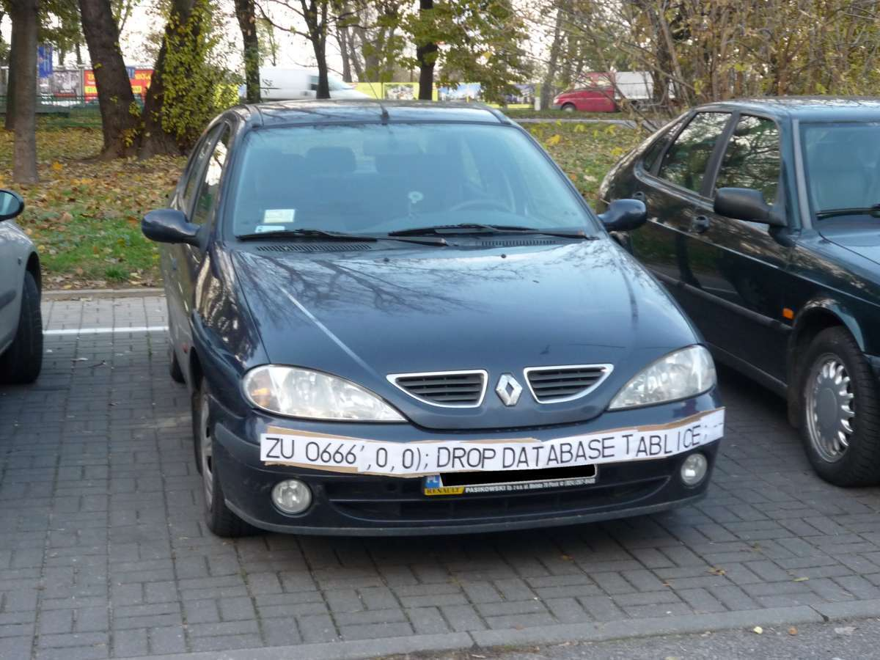

Slide 31
Web Pen Test Tools
Links from Steve McIntosh live demo presentation.

Slide 32
OWASP Vulnerable Web Applications Directory Project
https://www.owasp.org/index.php/OWASP_Vulnerable_Web_Applications_Directory_Project
List of sample vulnerable web applications.
On-Line applications
Off-Line applications
Virtual Machines and ISO images

Slide 33
Web Security Dojo
https://www.mavensecurity.com/resources/web-security-dojo/

Slide 34
OWASP ZAP (Zed Attack Proxy Project)
https://www.owasp.org/index.php/OWASP_Zed_Attack_Proxy_Project
Java application
Automated scanner
Manual tools
Extensions

Slide 35
SQLmap
http://sqlmap.org/
Multiple DB support
Password cracking
Download/upload files
Run commands DB and OS

Slide 36
WebScarab
https://www.owasp.org/index.php/Category:OWASP_WebScarab_Project
Attack proxy, functionality now included in OWASP ZAP.

Slide 37
“Do”s
Try it yourself
Against your own applications
Against each other's (with permission!)

Slide 38
“Don’t”s
Attack without permission
Hack the Internet

Slide 39
Other useful resources:

Slide 40
Kali
https://www.kali.org/
Penetration testing distribution
Debian (Ubuntu)
32bit/64bit/ARM
Vmware, VirtualBox

Slide 41
More web pen test tools
http://sectools.org/tag/web-scanners/
http://www.toolswatch.org/2016/02/2015-top-security-tools-as-voted-by-toolswatch-org-readers/

